Slide 1

Revolutionizing Employee Management: Building a Serverless DynamoDB Project with API Gateway

Slide 2

Welcome to the Revolution
In this presentation, we will explore the creative journey of building a serverless DynamoDB project with API Gateway, revolutionizing employee management. Get ready to unleash the power of modern technology!

Slide 3

Embrace the ﬂexibility and scalability of serverless architecture. Say goodbye to server maintenance and hello to seamless scalability. Let's dive into the world of serverless computing!
Understanding Serverless Architecture

Slide 4

Discover the versatility and power of DynamoDB, a fully managed NoSQL database service. Learn how to leverage its capabilities to efﬁciently manage employee data and beyond.
Unleashing DynamoDB's Potential

Slide 5

Empowering with API Gateway
Empower your applications with the agility and security of API Gateway. Explore how to seamlessly integrate with DynamoDB and provide a robust interface for employee management.

Slide 6

Designing the Project Architecture
Architect a modern and scalable serverless project. We'll explore the best practices for designing a robust and efﬁcient system for employee management.

Slide 7

Implementing DynamoDB Data Model
Leverage the ﬂexibility of DynamoDB's data model to create a tailored solution for managing employee information. Let's explore the best practices for data modeling.

Slide 8

Building API Endpoints
Craft intuitive and secure API endpoints to interact with the DynamoDB project. We'll delve into the process of creating robust endpoints for seamless data management.

Slide 9

Enhancing Security and Performance
Prioritize security and optimize performance in the serverless project. Learn the essential strategies for securing data and maximizing system efﬁciency.

Slide 10

Revolutionize employee management with a serverless DynamoDB project. Embrace the future of technology to create a seamless, scalable, and efﬁcient system.
Embracing Innovation in Employee Management

Slide 11
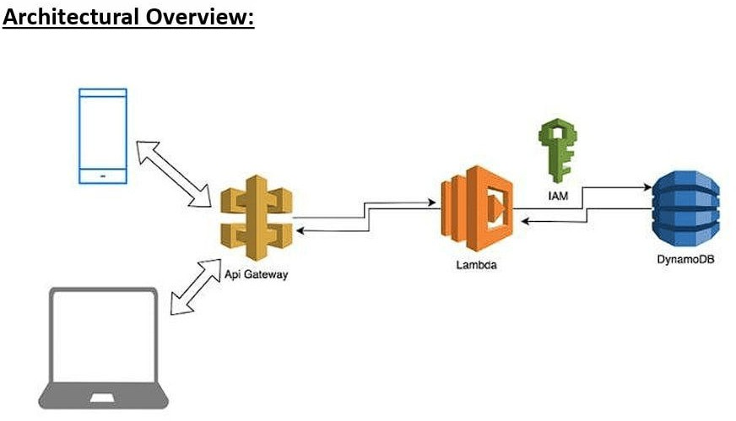

Slide 12
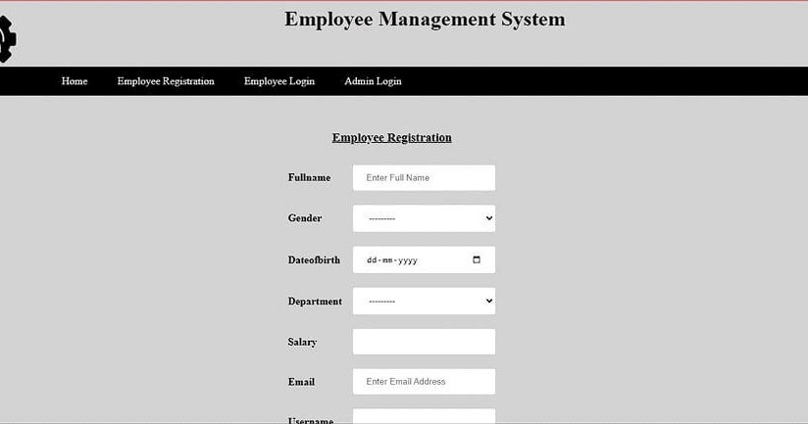

Slide 13

Empower Your Team with Serverless DynamoDB
You're now equipped to embark on the journey of revolutionizing employee management.
Embrace the power of serverless
architecture and DynamoDB to empower your team and drive innovation.

Slide 14
Thanks!

